Slide 1

University Institute of Engineering
Course Name- Communication Skills
Course Code- 23PCH-105
CORRECTION OF SENTENCES
DISCOVER . LEARN . EMPOWER

Slide 2
COURSE OBJECTIVES
The Course aims to:
1 | Augment students overall communication and interpersonal skills by making them realize the importance of good oral and written English Language in professional life.
2 | Enrich their reading capability with special emphasis on expanding vocabulary and grammatical formations.
3 | Build exceptional speaking, reading and writing skills by correcting grammatical errors and pronunciation through practice.
4 | Enhances soft skills by fostering self awareness, confidence and a positive attitude in students’ ability to communicate effectively in English.

Slide 3
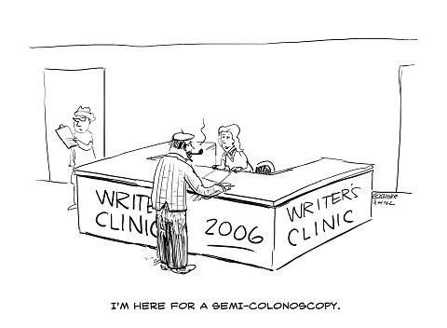
COURSE OUTCOMES
On completion, the students are expected to:
CO Number | Title | Level
CO1 | Apply appropriate Listening, Speaking, Reading and Writing Skills (LSRW Skills) with correct non-verbal cues to attain expertise in soft skills. | Apply
CO2 | Apply correct contextual and comprehensible written text in the form of paragraph writing, short compositions business correspondence, using logical support and argument in a wide range of communication situations. | Apply
CO3 | Demonstrate linguistic competence while speaking and during presentations through accuracy in grammatical usage, vocabulary, pronunciation and intonation. | Apply
CO4 | Evaluate information as critical readers, speakers and writers applying ethics in communication and being sensitive in cross cultural communication. | Evaluate
CO5 | Create original, digital content for websites, blogs, vlogs and personal social media profiles etc. | Create

Slide 4
Course Outcomes
On completion, the students are expected to
CO Number | Title | Level
CO1 | Evaluate facts to write research and short official, technical or social reports. | Evaluate
CO2 | Create communication material for an organization dedicated to a social cause and use electronic/social media to share concepts and ideas. | Create
CO3 | Analyse and summarize information, ideas and opinions on a social issue using grammatically correct English. | Analyse
CO4 | Perform effectively in the placement process. | Apply
CO5 | Display moral values, ethics and sensitivity for diversity and inclusion. | Apply
pinterest.com
Notes:
https://www.google.com/url?sa=i&url=https%3A%2F%2Fsloanreview.mit.edu%2Farticle%2Ffive-ways-to-improve-communication-in-virtual-teams%2F&psig=AOvVaw0TTElm7CjMaUyvrnZ7z0V9&ust=1591773620787000&source=images&cd=vfe&ved=0CAIQjRxqFwoTCKi454SZ9OkCFQAAAAAdAAAAABAO

Slide 5
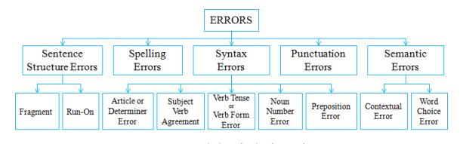
Types of Errors

Slide 6
Sentence Structure Errors
Sentence structure determines how the different parts of a sentence are put together, from its punctuation to the ordering of its words.
There are two especially common sentence construction mistakes:
Sentence fragments: missing necessary components to form a full grammatically correct sentence.
Run-on sentences: incorrect punctuation used to join different parts of a sentence.

Slide 7
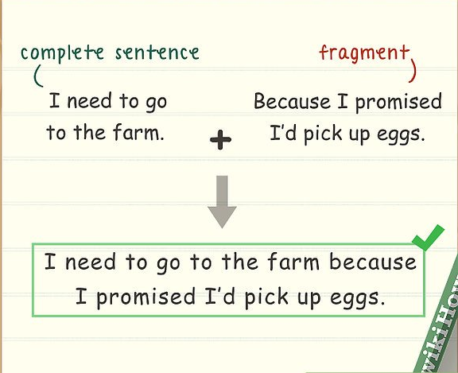
Fragments
A complete sentence must have three components:
A subject (the actor in the sentence)
A predicate (the verb or action)
A complete thought (it can stand alone and make sense).
A fragment is an incomplete sentence.

Slide 8
Fragments
It cannot stand alone and does not express a complete thought.
Some fragments lack either a subject or verb or both.
Dependent clauses are also fragments if they stand alone.
Example:
Went out of business after Starbucks Coffee opened.
One of my friends who won a contest by playing a variety of instruments.
Since I went fishing.

Slide 9
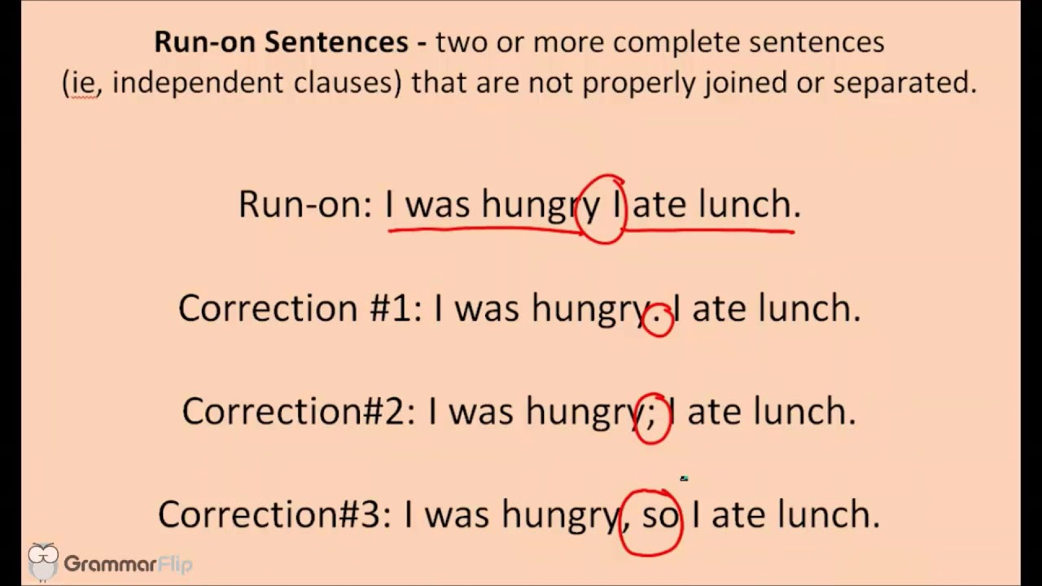
Run-on Sentences
A run-on sentence is not simply a long sentence.
It might include:
Lack of punctuation and/or conjunctions
Incorrect punctuation
A comma splice—two independent clauses joined by a comma—is a run-on sentence.

Slide 10
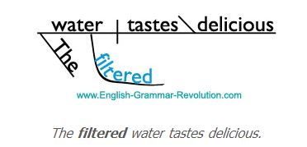
Dangling Participles
A dangling participle is a word or phrase that modifies a word not clearly stated or an unintended noun in the sentence.
Example:
He chased the monkey with his hat.
(He chased the monkey wearing his hat or the monkey had his hat?)
Correct: Wearing his hat, he chased the monkey.
(The participle has to be next to the noun that it modifies. The participle phrase ’wearing his hat’ modifies ’he’.)

Slide 11
Poll Question 1
Q. Coming around the corner, the skyscrapers came clearly into view across the river.
Coming around the corner, the skyscrapers are viewed clearly across the river.
Coming around the corner, the skyscrapers came clearly into view across the river.
Coming around the corner, the people got a view of the skyscrapers across the river.
Comes around the corner, the skyscrapers came clearly into view across the river.

Slide 12
Subject/Verb Agreement
Singular subjects must have singular verbs.
Plural subjects must have plural verbs.
Rule of thumb:
Subjects ending in “s” are plural
Verbs ending in “s” are singular
For Example:
The box of ornaments belong in the attic.
High levels of mercury occurs in some fish.
What we need are more pots and pans.

Slide 13
Pronoun/Antecedent Agreement
Pronouns are words that take the place of nouns while Antecedents are the words that the pronouns refer to.
Pronouns must agree with their antecedents in number, gender, and person.
Number = singular or plural
Gender = masculine, feminine, or neuter
Person = 1st, 2nd, or 3rd person
Example:
Everyone should make their own decisions.
Each speaker maintained their poise.

Slide 14
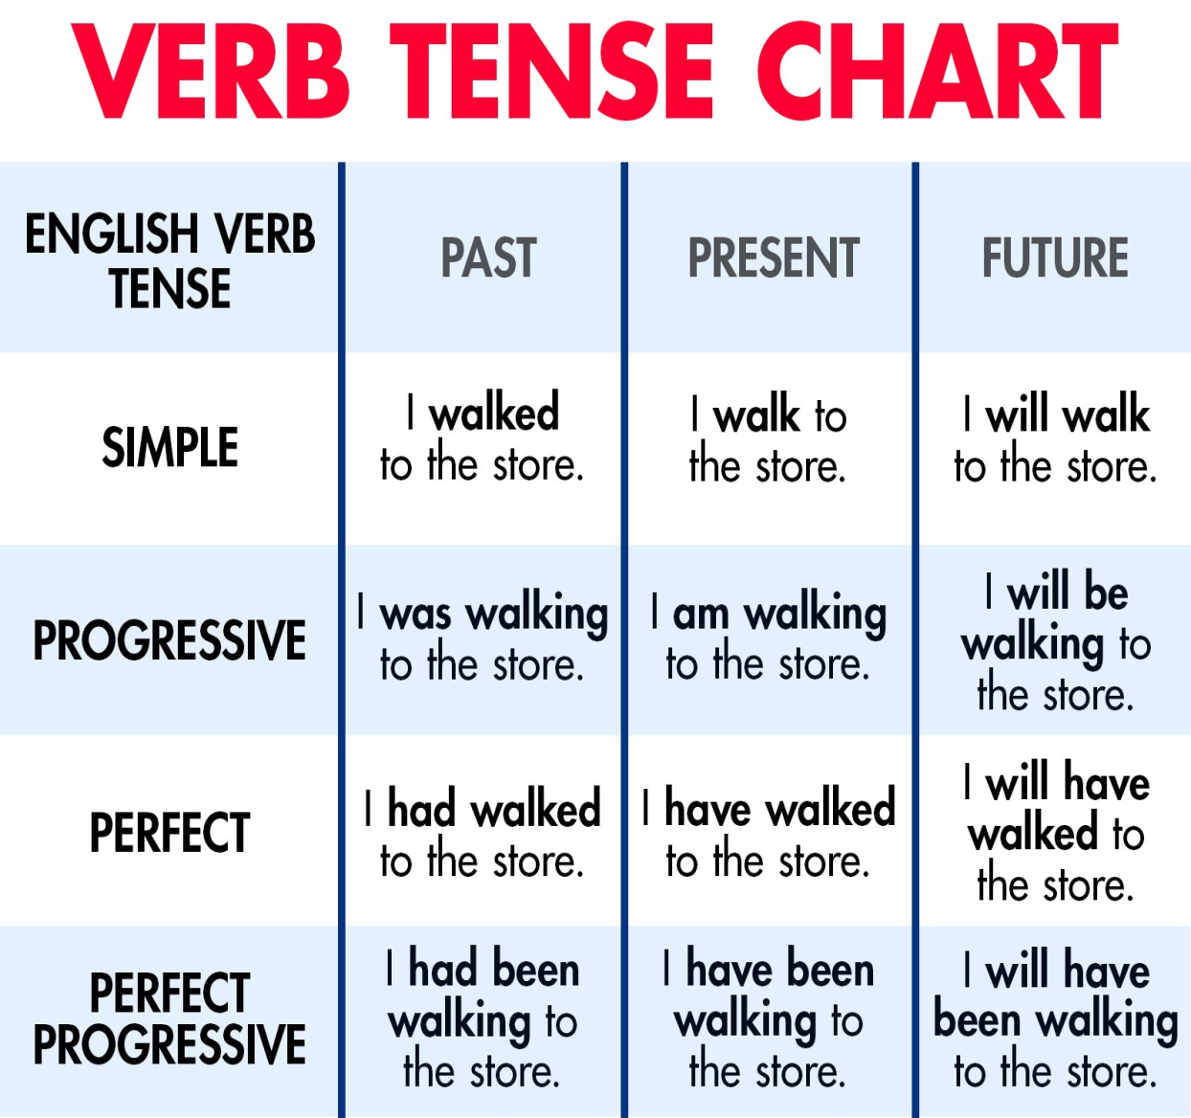
Verb Tense
There are three verb tenses in English Language: Past, Present and Future.
The present, past and future tenses are divided into four types: Simple, continuous, perfect and perfect continuous.

Slide 15
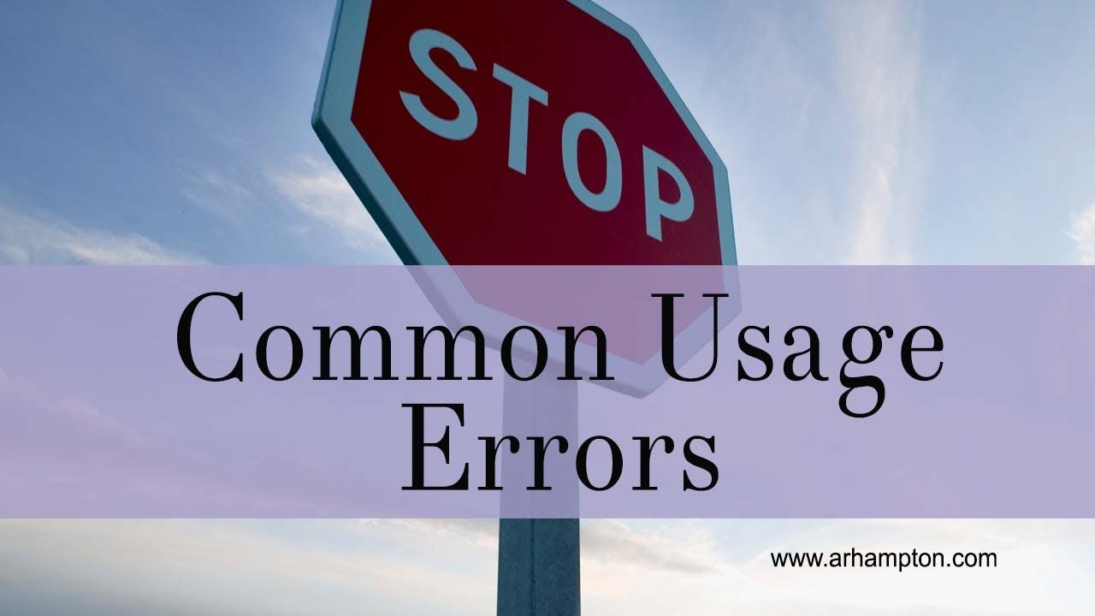

Slide 16
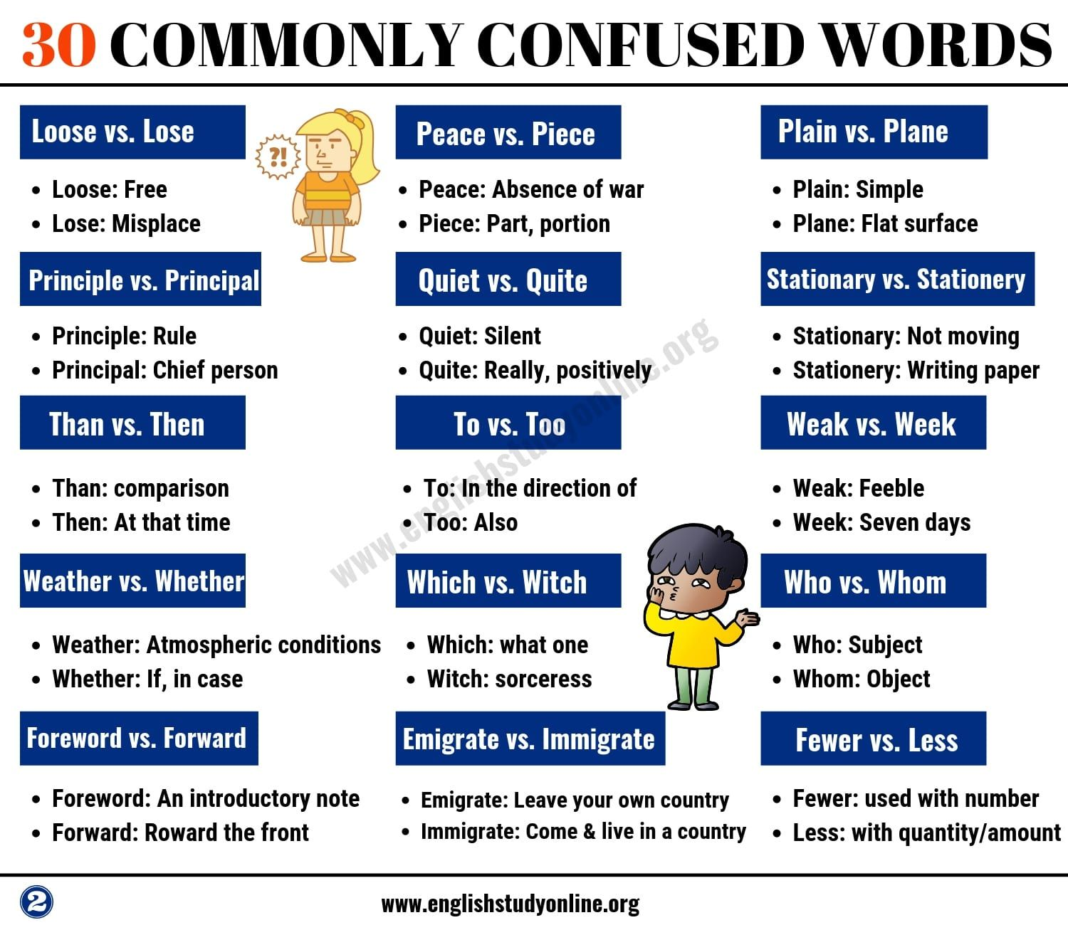
Commonly Confused Words

Slide 17
Commonly Confused Words
They're / Their / There
They’re going to store together. (contraction of “they are”)
The managers are in their weekly meeting. (possessive)
Place the flowers there. (adv. – indicates location/direction)
You're / Your
You're going to be a great writer! (contraction of “you are”)
Your hair looks nice today. (possessive)
Who's / Whose
Who's on first base? (contraction of “who is”)
Whose watch is this? (possession)

Slide 18
Commonly Confused Words
It's / Its / Its’
It’s a beautiful day! (contraction of “it is”)
Download the program, along with its readme file. (possessive)
Its’ is not a word.
Affect / Effect
The outage shouldn't affect anyone during work hours. (verb – to act on, influence)
The outage shouldn't have any effect on users. (noun – result)

Slide 19
Commonly Confused Words
To / Too / Two
I am going to the store. (preposition)
She decided to go along too. (adv. – also)
I have two buttons missing. (number)
A lot / Alot / Allot
The workers are worrying a lot about their jobs. (adv. – to a great degree/extent)
Alot is not a word.
We were each allotted twenty tickets. (verb – to assign/distribute)

Slide 20
Poll Question 2
Q. A part of the sentence is underlined. Below are given alternatives to the bold part which may improve the sentence. Choose the correct alternative. In case no improvement is required, choose No Improvement' option.
He behaves as if he is the supreme leader.
as he is
as if he were
as if he was
No improvement

Slide 21

Preparation Tips to Solve Sentence Correction Questions
Keep the following things in mind while tackling a sentence correction question:
Identify the concept
Similar answer choices
Treat all options equally
Pay attention to the non-underlined part
Choose the shorter answer
Substitute the selected answer
Elimination technique

Slide 22
Applications
Students will be able to make correct sentences.
Students will have a better understanding of sentence structure and sentence formation.
It will improve their overall language.

Slide 23
Assessment Pattern
Students are assessed on the basis of the following parameters:
Hourly Test – 2
Assignments
Surprise Test
Quiz
Student Engagement
End Semester Exam

Slide 24
References
ISC Total English Class 12 by by P. Pinto, Xavier Pinto.
High School English Grammar and Composition Paperback by P.C. Wren, N.D.V. Prasada Rao
http://vdvdvdvdvdvdvdv.blogspot.com/2012/02/5-common-english-grammar-mistakes.html#!/2012/02/5-common-english-grammar-mistakes.html
http://writingcenter.unc.edu/handouts/fragments-and-run-ons/
http://booksoulmates.blogspot.com/2011/02/grammar-101-apostrophes.html
http://www.englishliteraturenotes.com/Grammar/Fragments.html

Slide 25
THANK YOU
For queries
Email: communicationskills.uilah@gmail.com

